Slide 1
Superstore Sales Analysis using Tableau
Transforming Data into Insights
Presented by
Ishika Goel

Slide 2

Introduction
Analyzed Superstore data to uncover sales, profit, and regional trends.
Created an interactive Tableau dashboard for actionable insights.
Objective: Drive growth through data-driven decisions.

Slide 3
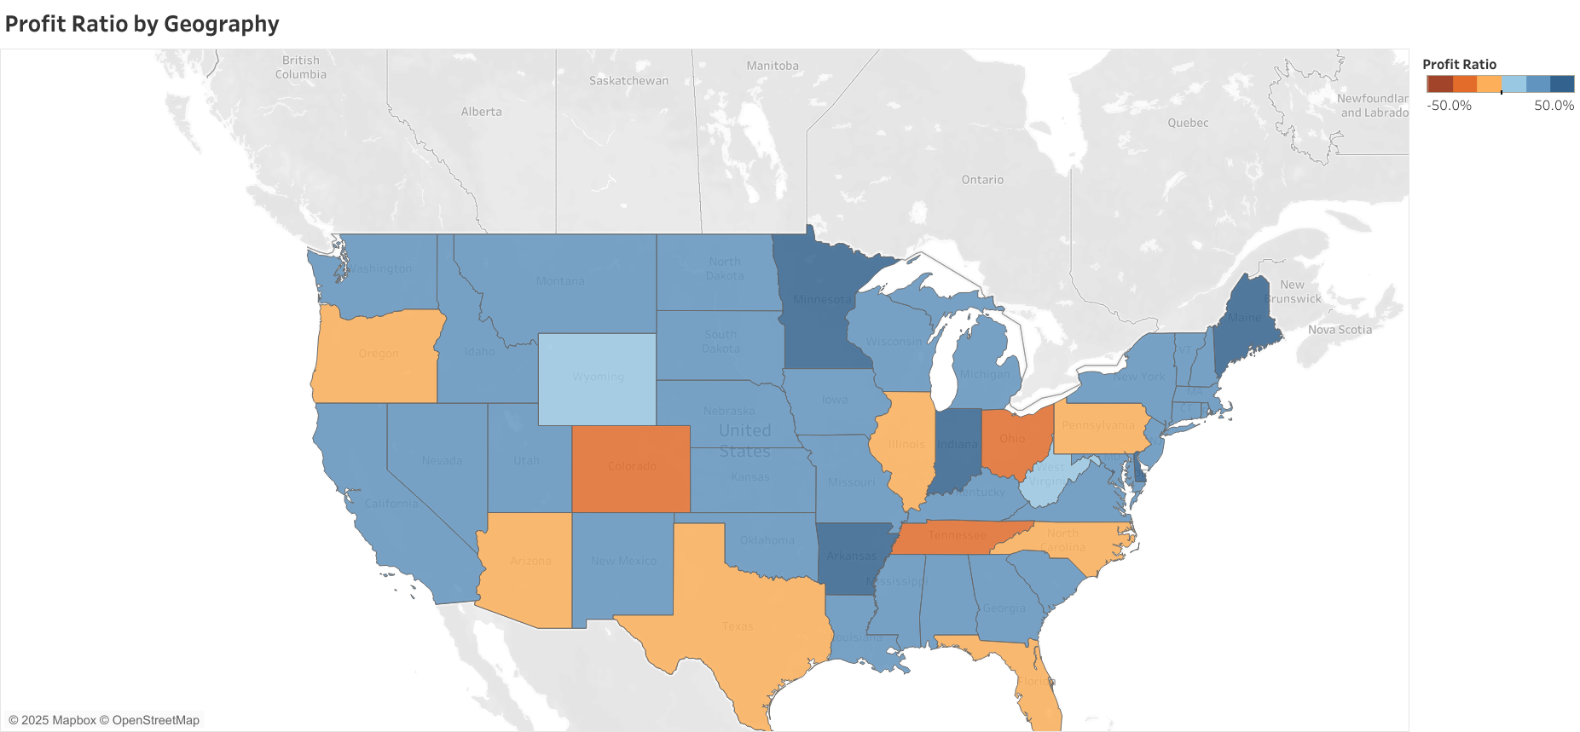
Profit Ratio by Geography
KPI Used: Country, State, and Profit Ratio

Slide 4
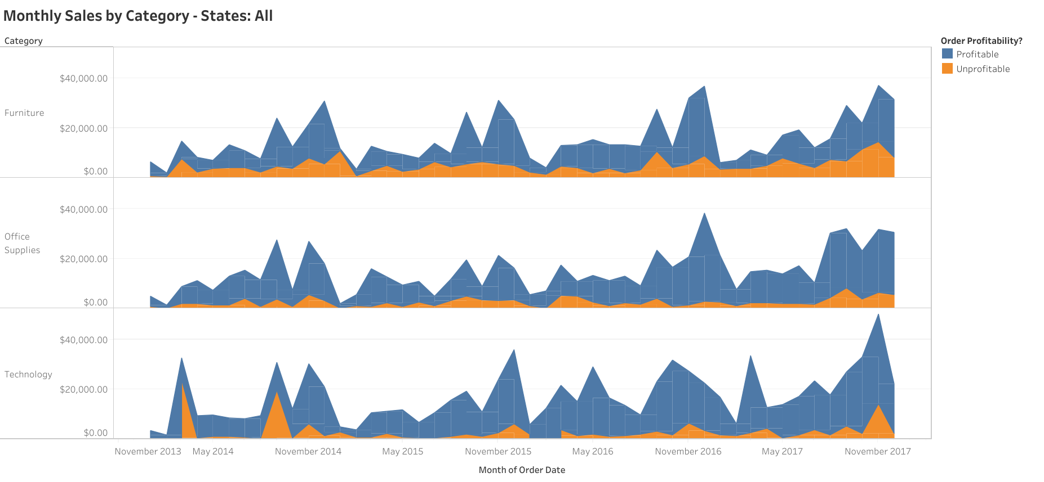
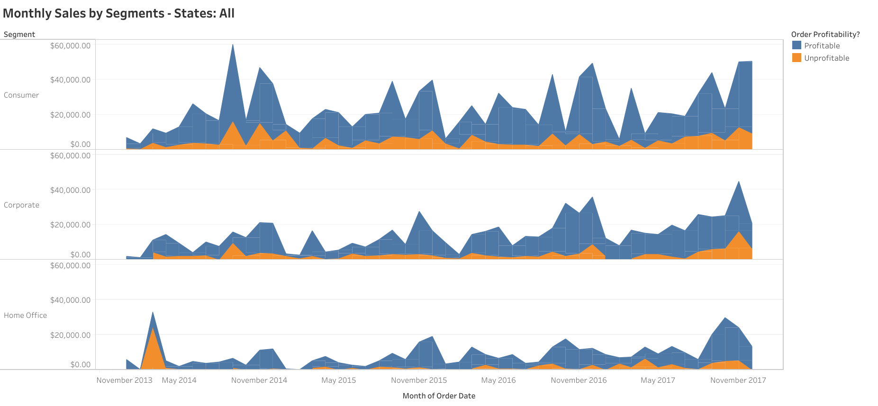
Monthly Sales
KPI Used: Profit and Order Profitability

Slide 5
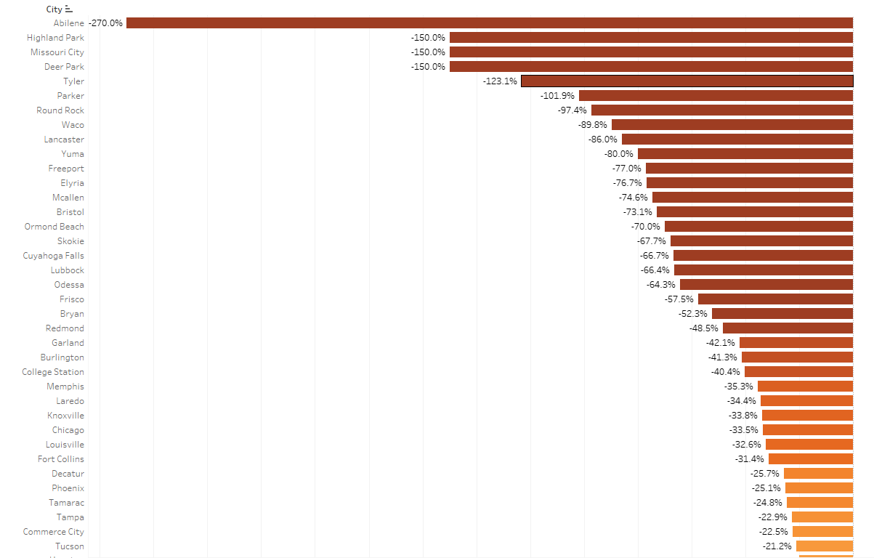
Profit Ratio by City
KPI Used: Order Date, Regions, and Profit Ratio

Slide 6
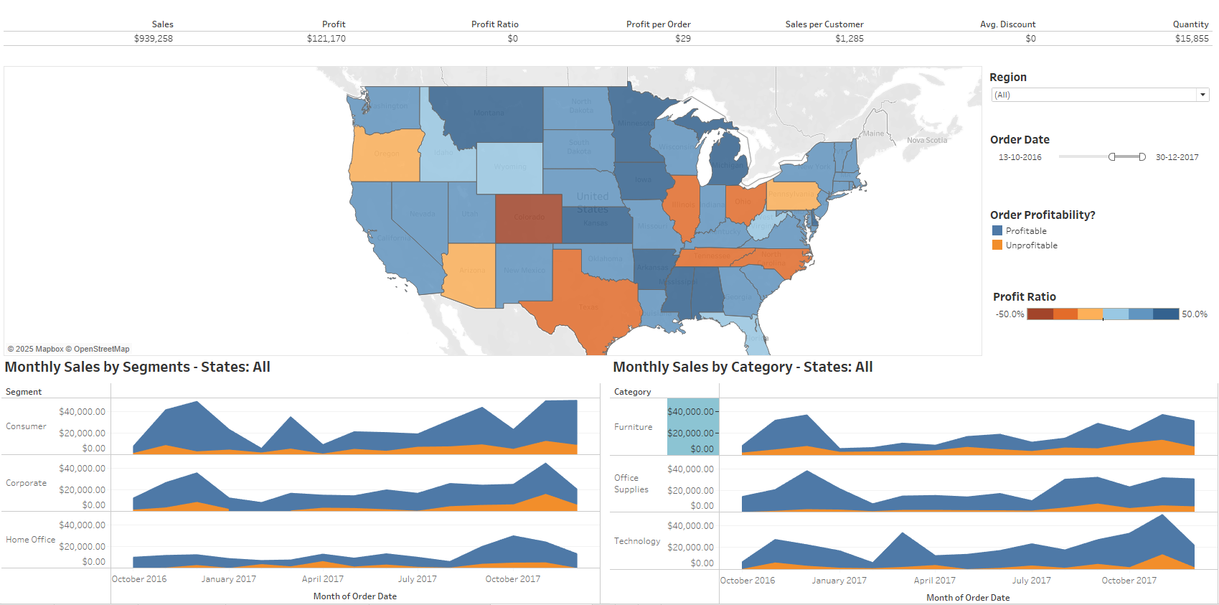
Superstore Sales Analysis Dashboard

Slide 7
Key Metrics
Total Sales: $2.3M
Total Profit: $286K
Profit Ratio: 12.4% (Profit Ratio = (Total Profit / Total Sales) x 100)
Top Region: West ($725K sales, $110K profit)
Challenging Region: South ($400K sales, $40K profit)

Slide 8
Insights
Best Category: Technology ($837K sales, $145K profit).
Underperforming Category: Furniture ($742K sales, $18K profit).
Customer Trends: Corporate customers lead; potential in Home Office segment.
Seasonality: Peak in November-December; dip in February-March.

Slide 9
Recommendations
Target South region with tailored strategies.
Optimize pricing and costs for Furniture category.
Launch promotions for Home Office customers.
Boost sales during low months with seasonal campaigns.

Slide 10
Conclusion
This project demonstrates how Tableau can transform complex data into actionable business insights. By analyzing key metrics such as sales, profit, and regional performance, the dashboard highlights areas for improvement and growth, including optimizing low-performing categories and capitalizing on high-value customer segments. The data-driven insights empower businesses to make informed strategic decisions, enhance customer engagement, and drive profitability in targeted regions and categories. This project underscores the value of effective data visualization in shaping business strategies.

Slide 11
Thank You!
Can connect over
LinkedIn: https://www.linkedin.com/in/ishika-goel-533b2b124/
DataSciencePortfolio: https://www.datascienceportfol.io/Ishikagoel2400
Github: https://github.com/ishikagoel24

